Slide 1

Intro to Practical development
Making things with raspberry Pi and Python!

Slide 2


before we begin
Logistics and important info
Introductions
What you will get out of today

Slide 3
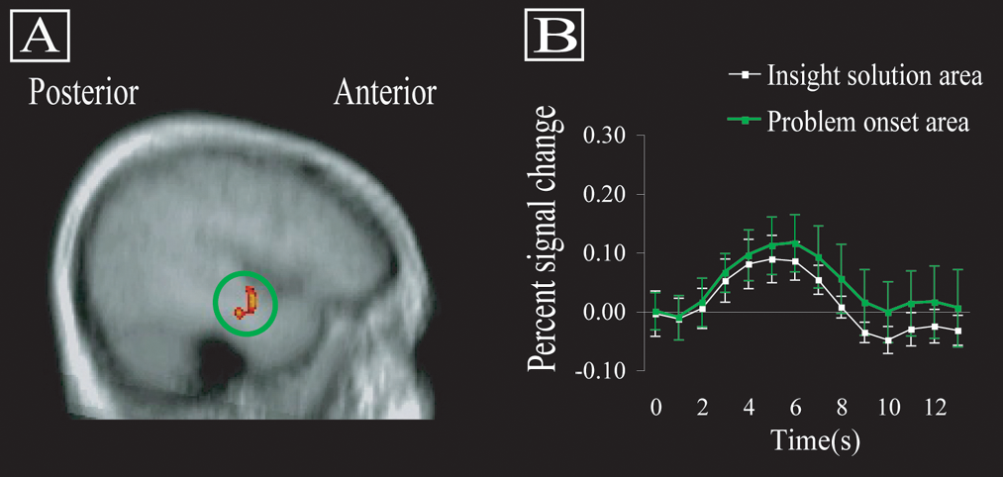
Practical Development
Why “practical” development?
Physical confirmation of logical creations
The “aha” moment

Slide 4
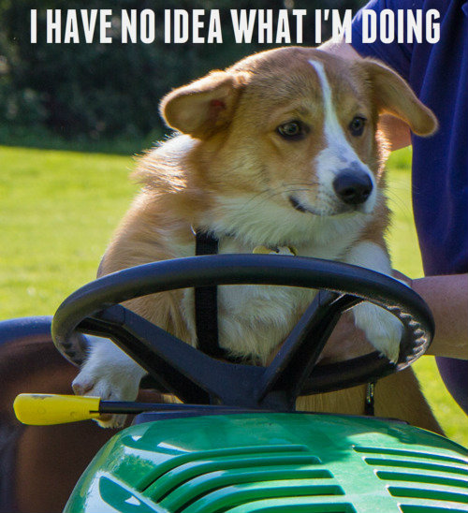
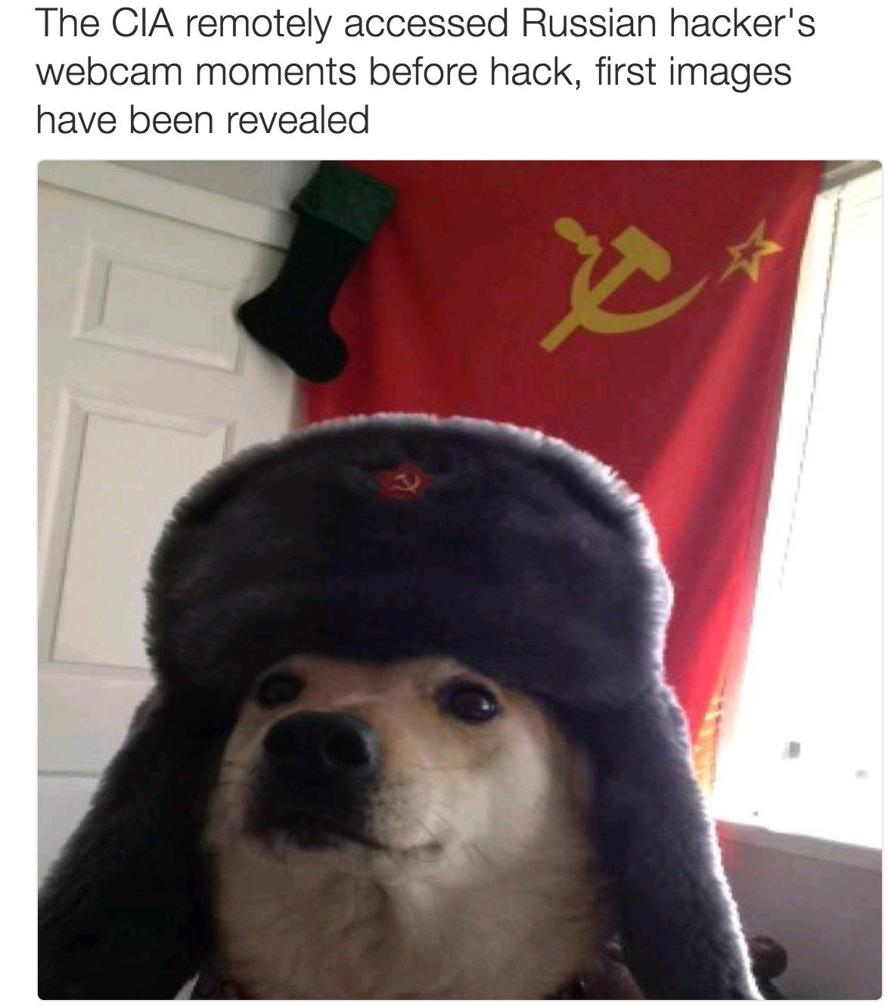
What *are* we doing?
Building our prototype
Coding our application
Testing our solution
Making! Hacking! Developing!

Slide 5
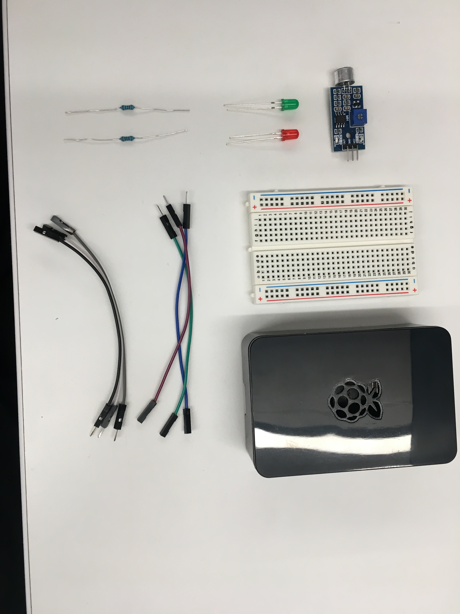
Hardware – AKA What’s in the box
Basic hardware required to build our project
Breadboard
Wires
Lights
Resistors
Sensor
Raspberry Pi 3

Slide 6
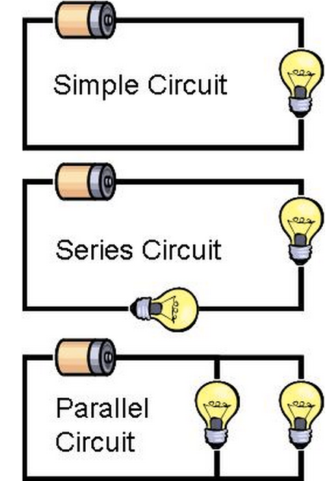
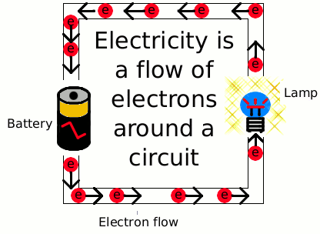
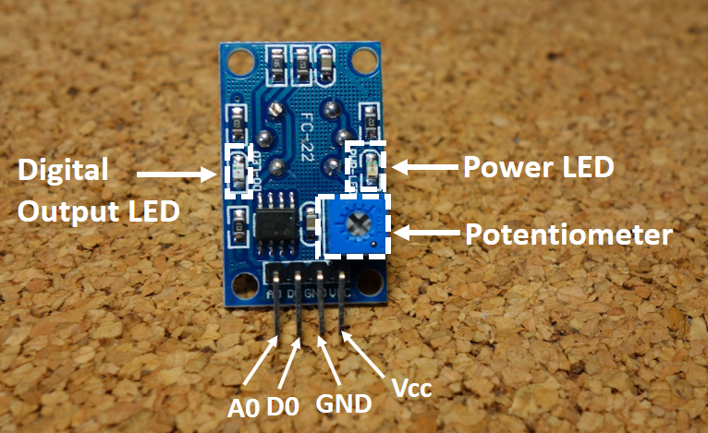
Hardware fundamentals
HW is all about Flow Control
We will build a circuit (3 of them)
Common Sensor pinout
VCC = power IN
GND = power OUT (Ground)
A0 = Analog output (Sometimes)
D0 = Digital output (Sometimes)
Usually you get one or the other of those

Slide 7
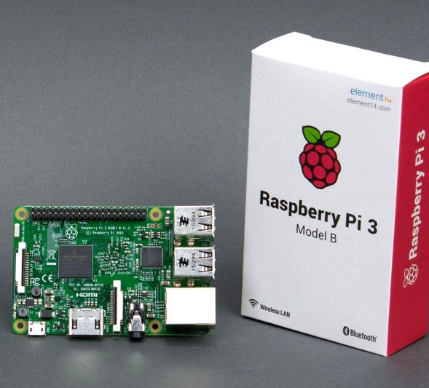
Raspberry Pi
Why Pi for IoT?
Cost
Accessibility
Community
Peripherals
First to market
Small, light, and “good enough”

Slide 8
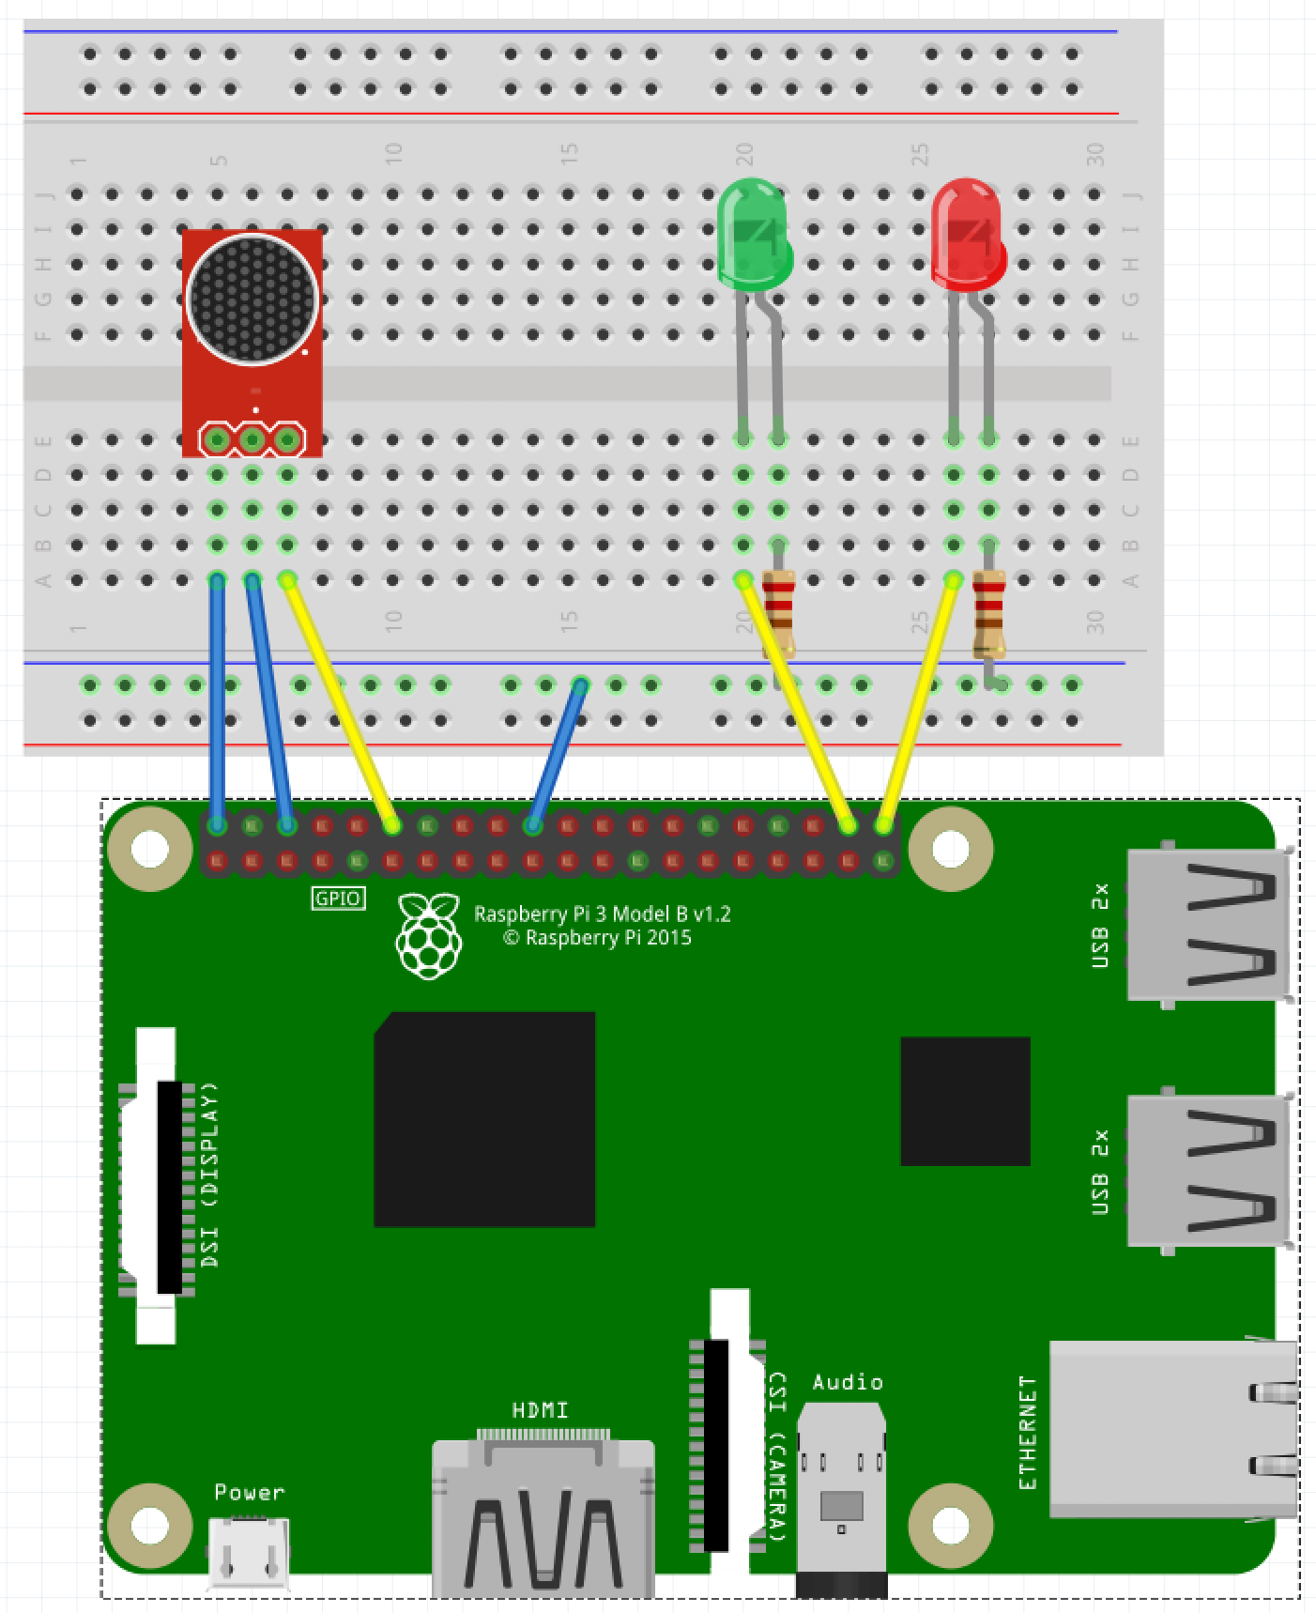
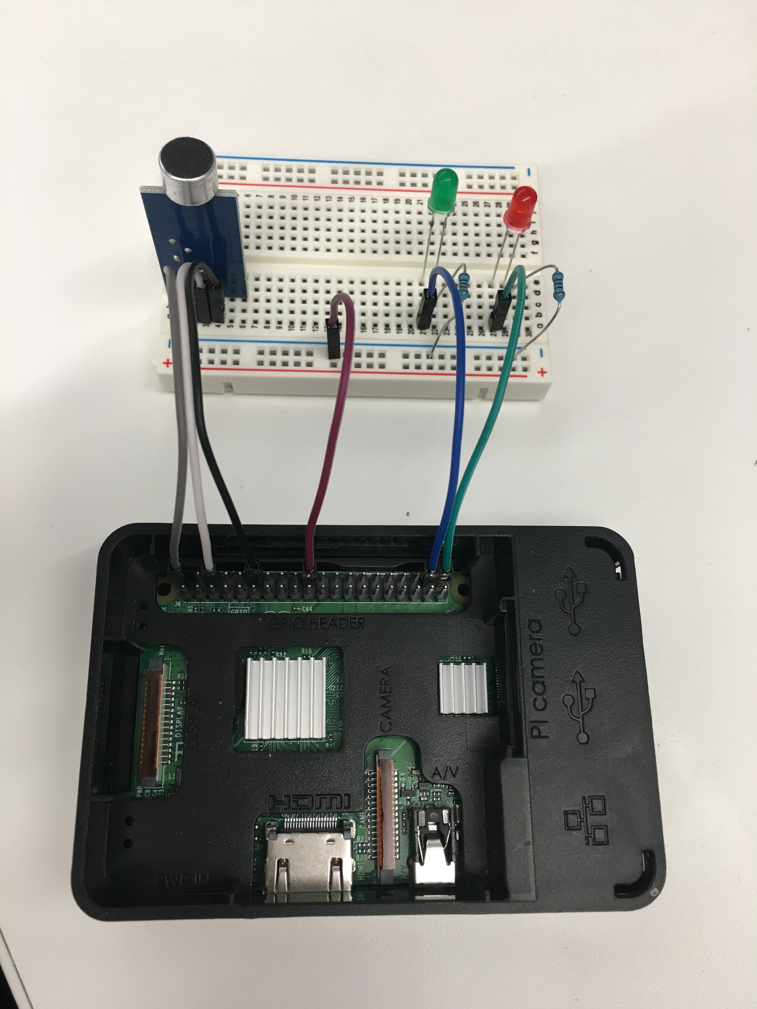
Slapping it all together
KISS – keep it simple, son!
Interpreting diagrams
Creating our circuits!

Slide 9
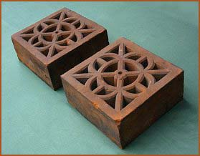
Now we have a Fancy Brick
It looks cool!
It matches the picture
It doesn’t do anything
Yet!

Slide 10
Take 15 minutes to celebrate!

Slide 11
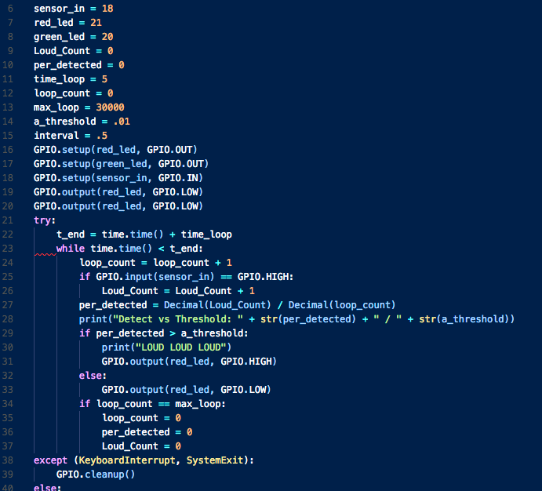
software
Variables
Functions
Inputs
Outputs
Notes:
Languages and syntaxes and etc… all boil down to 4 things:

Slide 12
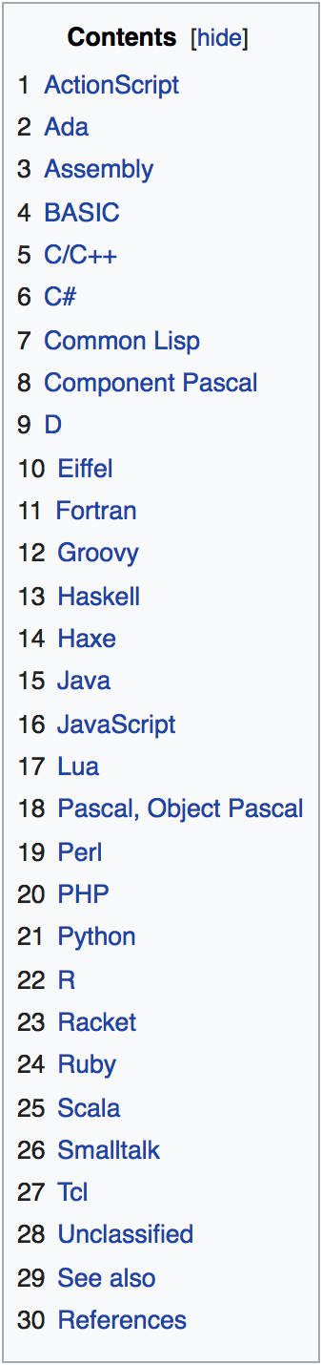

Code power!
How do we “build” software?
What are the resources you need?
Keeping track of code?

Slide 13
Getting started with writing code
A development tool
A place to save code
Access to other libraries and info

Slide 14
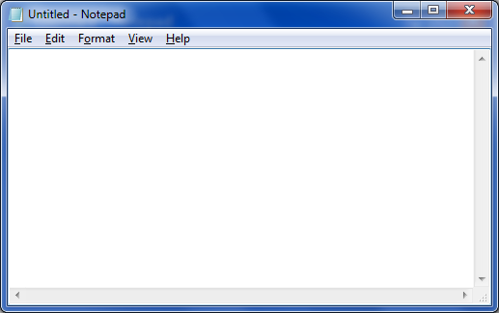
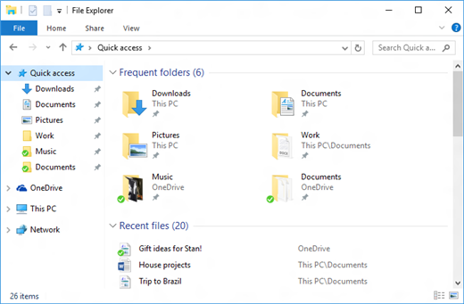









A TOOL
A PLACE TO PUT IT
RESOURCES

Slide 15
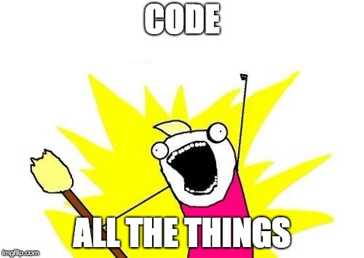

IT’s Coding time!

Slide 16
Take 15 more minutes to celebrate!

Slide 17
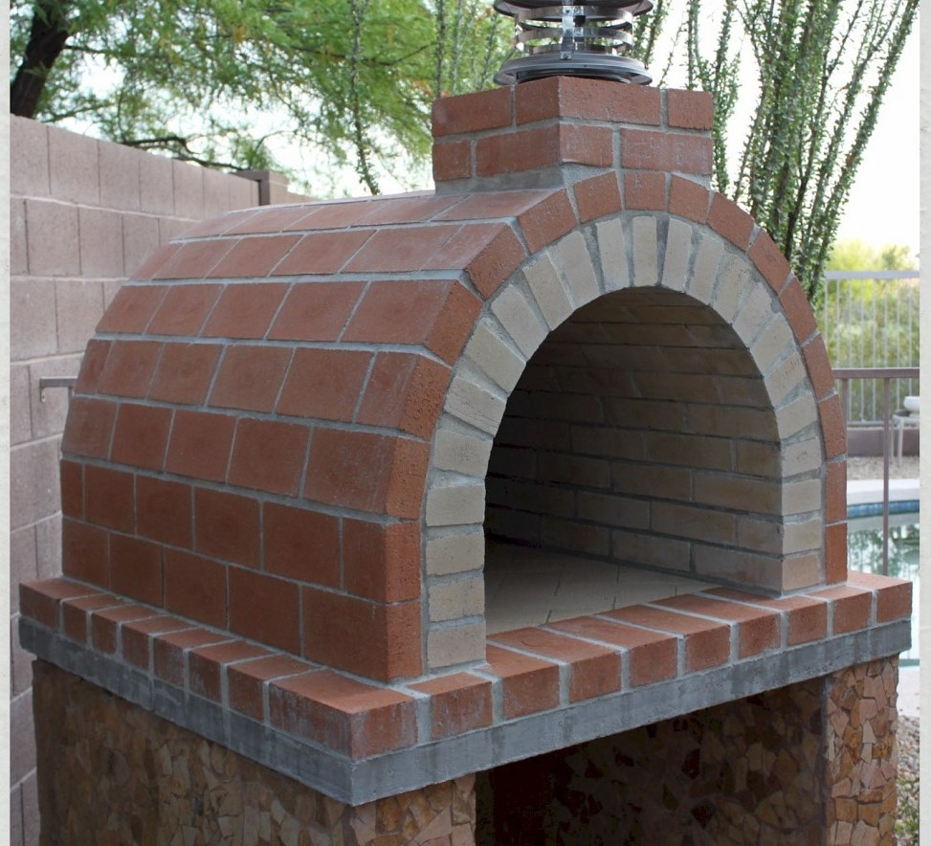
You have now made a brick oven!
It serves a functional purpose
It doesn’t just sit there
It works like you coded it to!

Slide 18
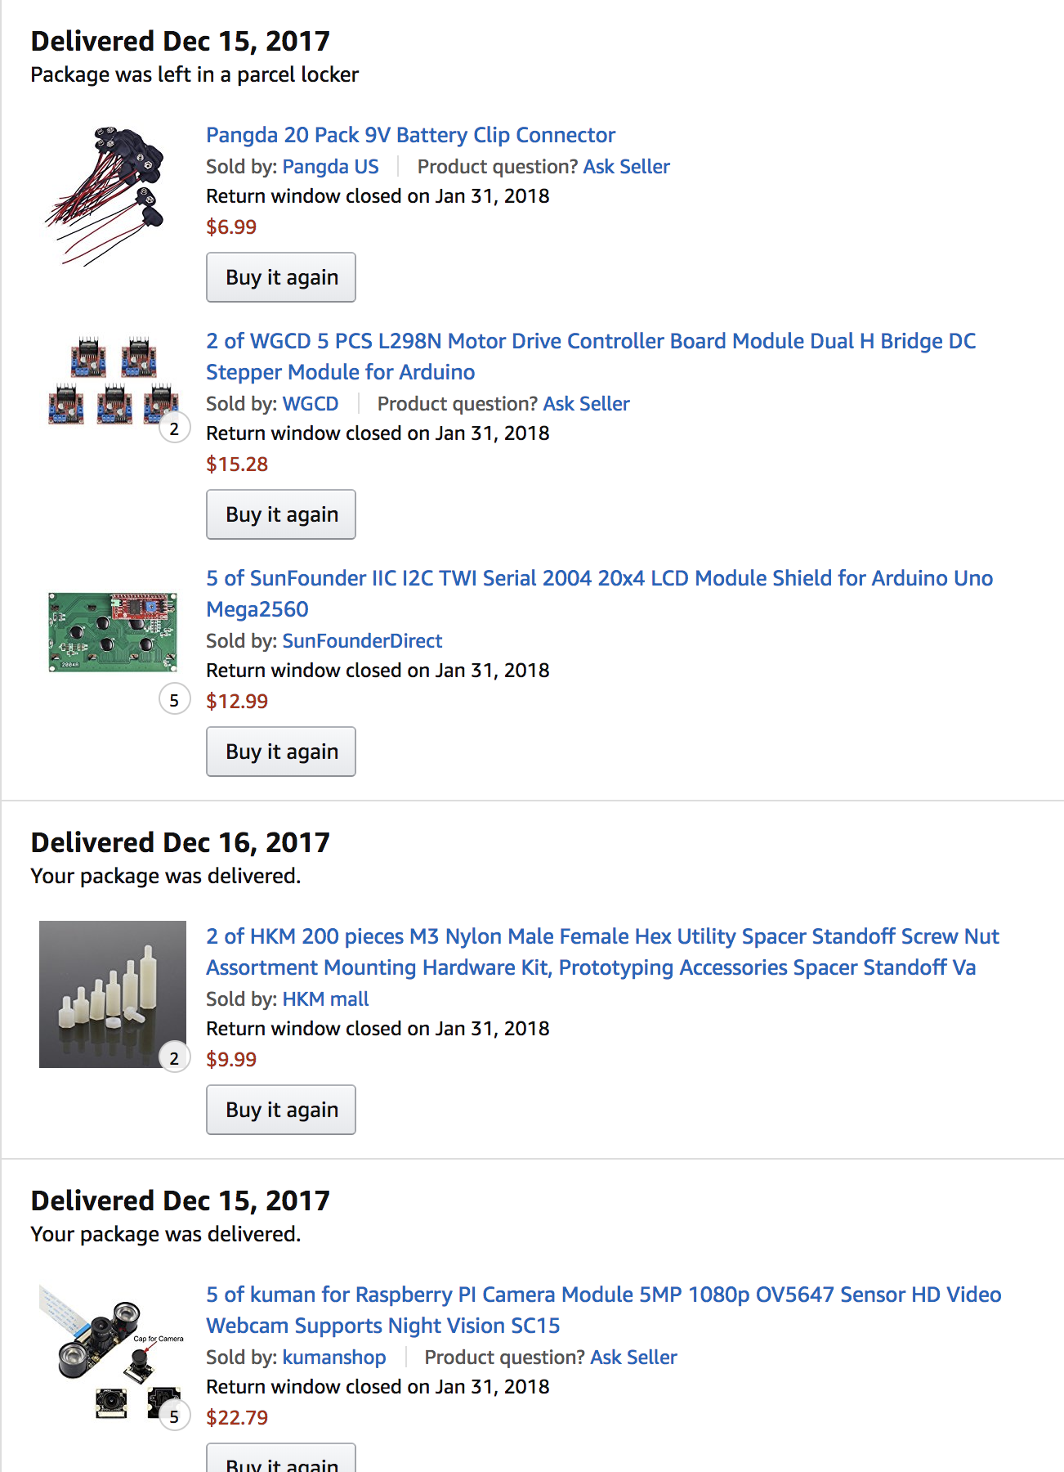
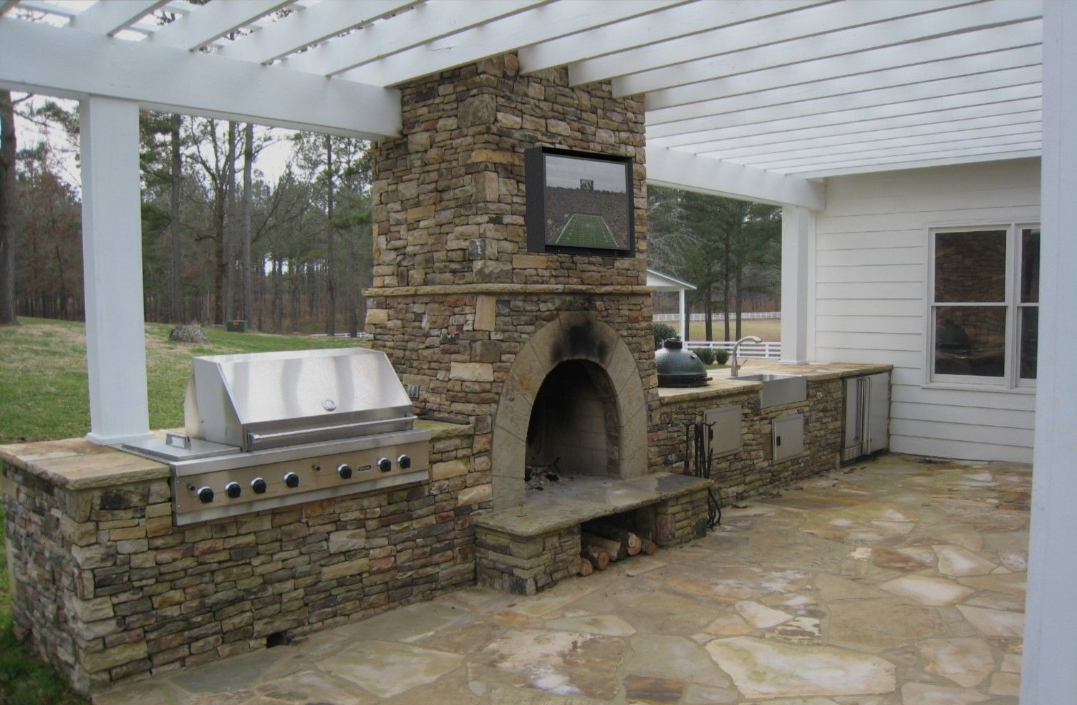
What’s next?
You have just taken the ”gateway drug” of making
Now your little oven will start to trigger new ideas and things you want to add
Soon you will have a fancy brick oven!
And your amazon order history will look like this:

Slide 19

What did we just do?!
Learned about hardware basics
Learned about the Raspberry PI
Learned some Python and development fundamentals
Took the first step into a much bigger world!

Slide 20

Congratulations!
You’re officially an IoT Developer! Don’t forget to come get your Sticker!!

Slide 21
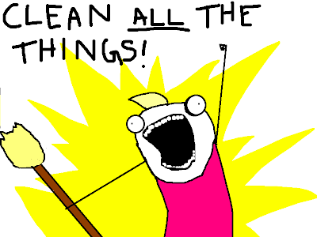
While we do Q and a
Disassemble your circuits
Put the parts in the baggie
Put everything back in the box
If you *really* want to keep your kit, let’s talk after

Slide 22
Some resources for you And a Favor for me
Official Resources:
Raspberypi.org
Python.org
Other Resources:
Youtube! Instructables! Amazon!
Github.com/ChrisHarrold
@charrold303 @codecoffeeyvr
A Favor:
http://bit.ly/charrold

